Slide 1
Unity Tools Programming
Start Improving Your Workflow

Slide 2








About Me
@defuncart
in/jamesjleahy/
James Leahy
2D Mobile
Game Developer
defuncart.com/games/

Slide 3
What is This Talk?
Who is This Talk For?
A general introduction on coding Editor Tools for Unity.
A short discussion on how such tools have helped improved our workflow.
Anyone using Unity!
Developers: code samples are of an intermediate level.
Non-Developers: learn how developers can help you!

Slide 4

GitHub
All code samples shown throughout this talk are available to download and use freely under an MIT licence.
github.com/defuncart/Talk-Unity-Tools-Programming

Slide 5
Unity Tools Programming
A tool is something which aids the team in creating the game, it is not a part of the final product.
  Artist → Pixel Art Editor.
  Game Designer → Level Editor.
  Sound Designer → Optimize music compression level.
  Automated build system.
  Localization database import.
  Reskin the UI for a Holiday event.

Slide 6
1. Inspector

Slide 7
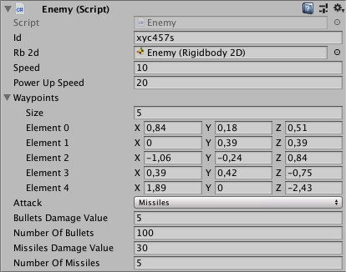
1. Inspector
The Inspector window displays detailed information about a component or an asset.
When there are numerous properties, the inspector can seem cluttered.
Often the person interacting with the inspector isn’t the script author.
Well laid-out inspectors are easier to understand and use.

Slide 8
1.1 Pimp the Inspector

Slide 9
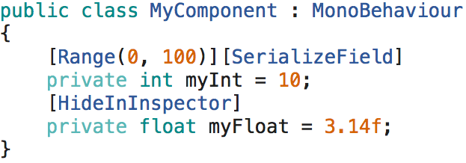

1.1 Pimp the Inspector : Attributes
[Range] constrains a float or an int to a certain range.
[SerializeField] exposes a private property in the Inspector.
[HideInInspector] hides a serialized property in the Inspector.

Slide 10
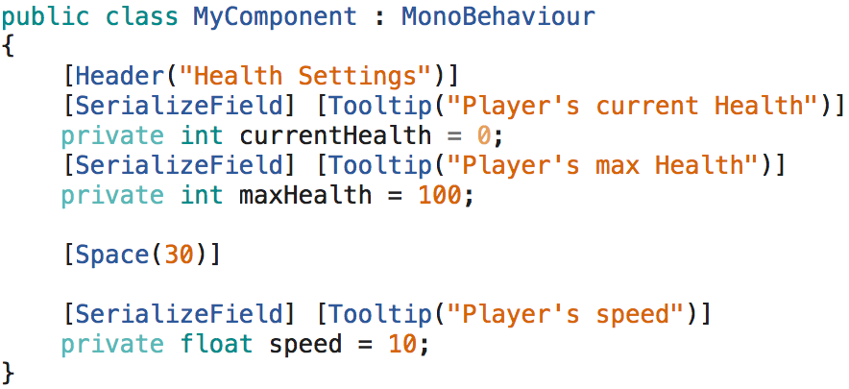
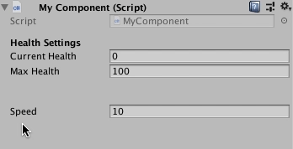
1.1 Pimp the Inspector : Attributes
[Header] adds a header above fields in the Inspector.
[Space] adds a space between fields in the Inspector.
[Tooltip] adds a tooltip for a field. This is visible when the mouse hovers over the field in the inspector.

Slide 11
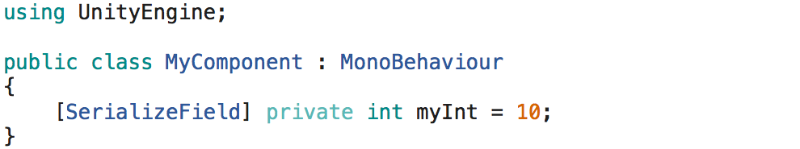
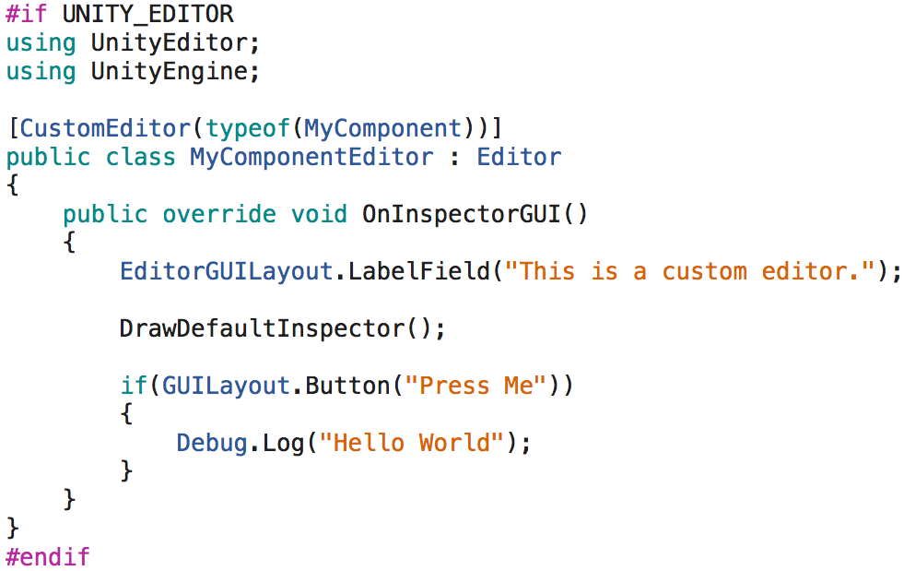

1.2 Pimp the Inspector : Custom Inspectors
By writing a script extending from Editor and overriding the callback OnInspectorGUI, we have complete control over the inspector's layout.

Slide 12


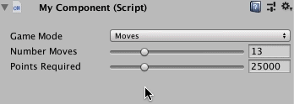
1.2 Pimp the Inspector : Custom Inspectors
A boolean used to display additional settings.
A fold-out group of seldom
used settings.
An enum used to display relevant settings for a game mode.

Slide 13
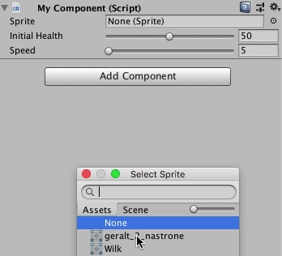
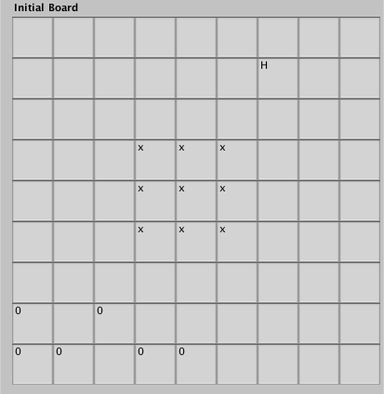
1.2 Pimp the Inspector : Custom Inspectors
Drawing a sprite property inside the inspector.
Visualizing a 2d array

Slide 14
2. Asset Import

Slide 15
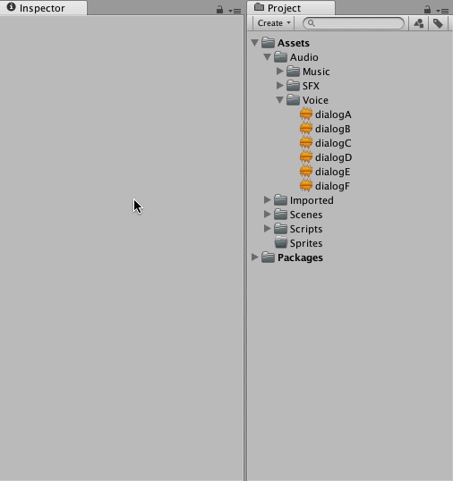
2. Asset Import
By group selecting files, settings for multiple files of the same type can be simultaneously updated.
However, this is
  repetitive,
  error-prone,
  easy to forget.
Wouldn’t it be great to be able to automate import settings?

Slide 16
2. Asset Import
AssetPostprocessor is an Editor class which allows access to the import pipeline and the ability to run scripts before or after importing assets.
Thus import settings can be specified in code and run on all assets of a certain type (i.e. audio) or those in a specific folder (i.e. Assets/Sprites/UI).

Slide 17
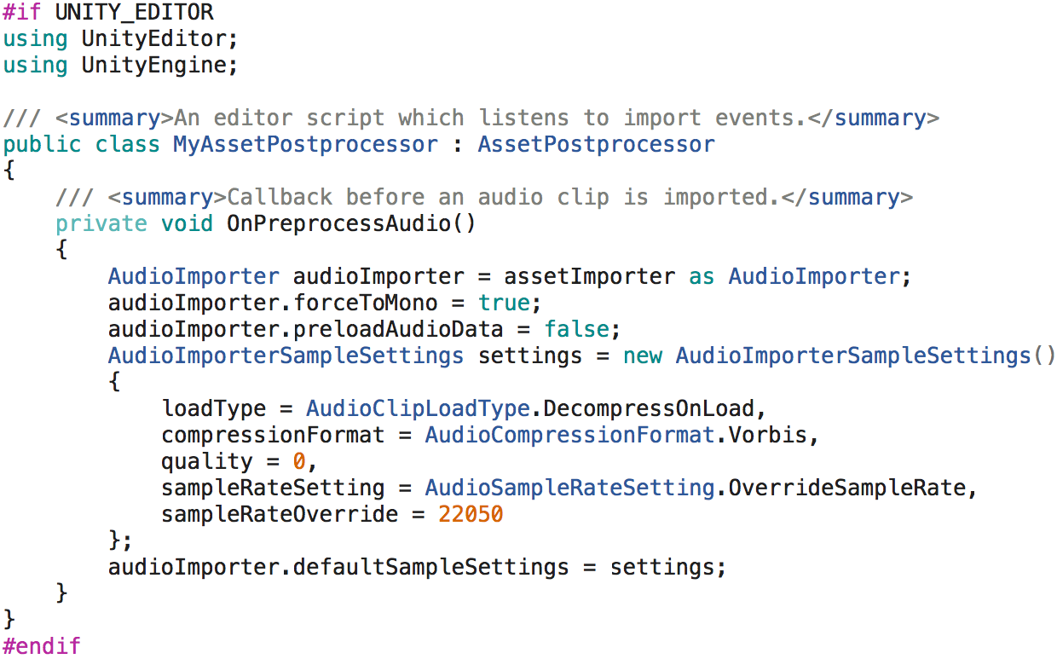
2.1 Asset Import : Audio Preprocess

Slide 18
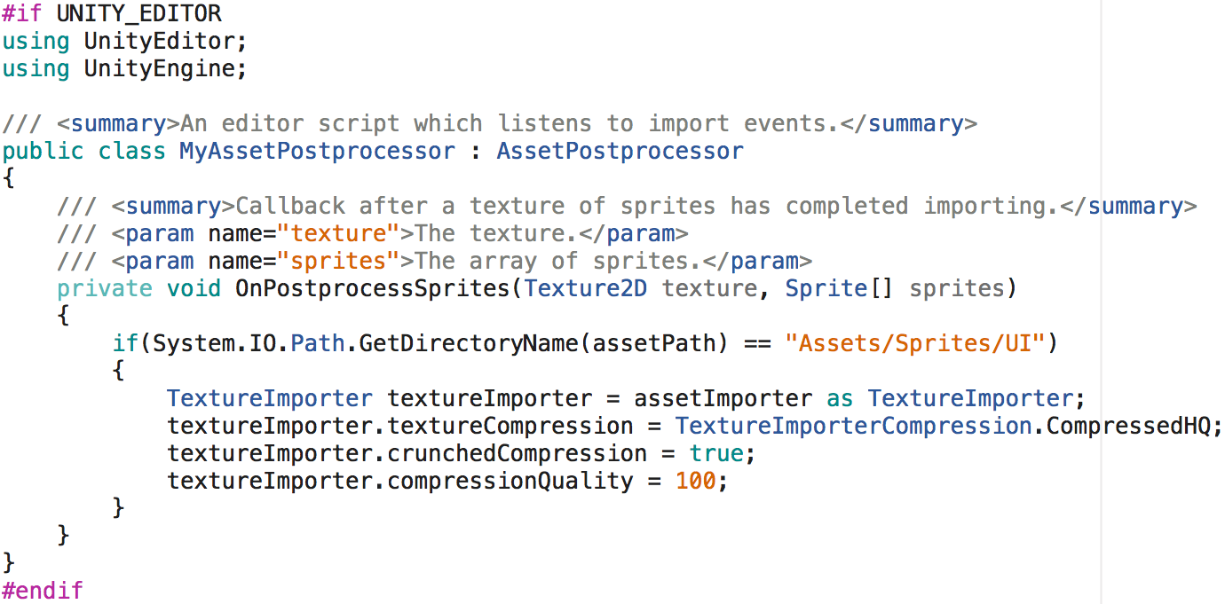
2.2 Asset Import : Sprite Postprocess

Slide 19
3. Custom Windows and Custom Menus

Slide 20
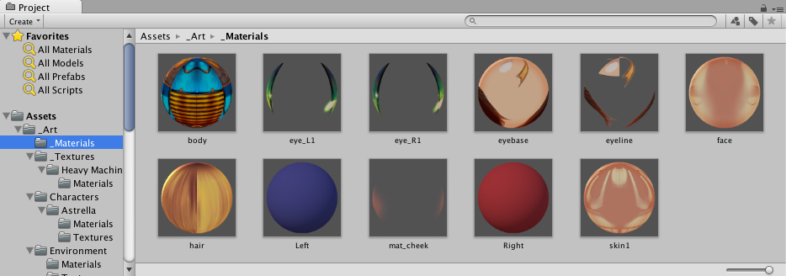
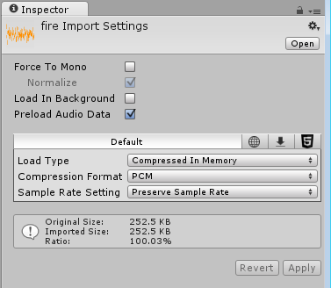
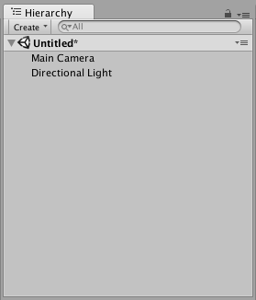
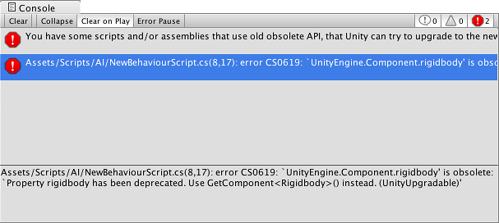
3.1 Custom Windows
The Unity Editor is a collection of windows.

Slide 21
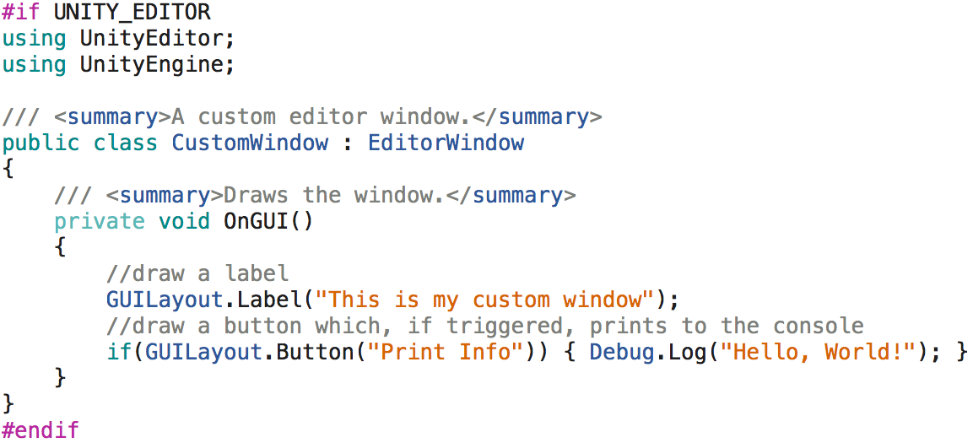
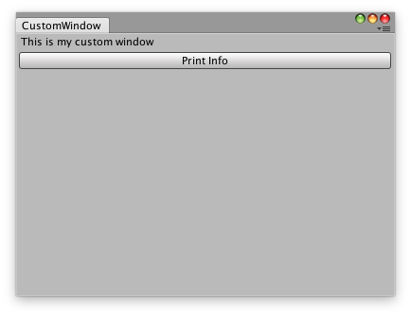
3.1 Custom Windows
Custom windows can easily be created by extending a new script from EditorWindow and implementing OnGUI.

Slide 22
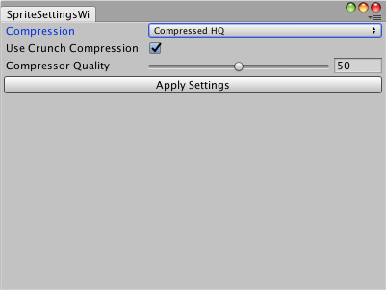
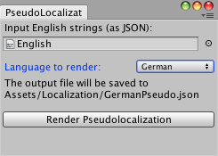
3.1 Custom Windows
A window which renders a Pseudolocalization for a target language.
A window which updates compression settings for all sprites.

Slide 23
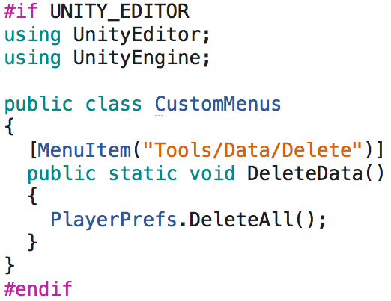

3.2.1 Custom Menus
The Unity Editor offers the addition of custom menus which look and behave like built-in menus.

Slide 24
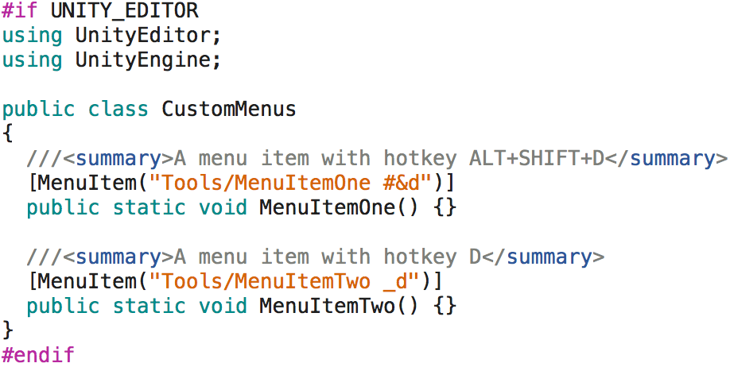

3.2.2 Custom Menus
These menu items can be assigned optional hotkey combinations (i.e. shortcuts) to automatically launch them.

Slide 25
3.2.3 Custom Menus
These hotkey combinations can be very useful to trigger functionality that would generally only be possible via mouse interactions.
Shortcut | Action
ALT + C | Copy Transform
ALT + V | Paste Transform
ALT + UP | Move sibling up
ALT + DOWN | Move sibling down
ALT + L | Lock Inspector
ALT + K | Toggle Inspector Debug Mode
SHIFT + F4 | Close Current Editor Window
SHIFT + ALT + C | Clear Console

Slide 26
Much, Much More!
Gizmos
ScriptableObjects
Custom Attributes
PropertyDrawer, DecoratorDrawer
Editor Dialogs
ContextMenu, ContextMenuItem
GUIStyle, GUISkin
Asset Store

Slide 27
Conclusion
Well laid-out inspectors are easier to understand and use.
Automate import settings.
Use hotkey combinations instead of mouse clicking.
A few minutes saved per person per day adds up to a very large number for a team over a project’s lifetime. Time saved = Money saved.
Listen to your team’s needs.

Slide 28
Dziękuję!

